Slide 1
Spatial Pyramid Pooling(SPP)^{[1]}
Zaoyi Chi
[1] Kaiming He, et al, Spatial Pyramid Pooling in Deep ConvolutionalNetworks for Visual Recognition

Slide 2
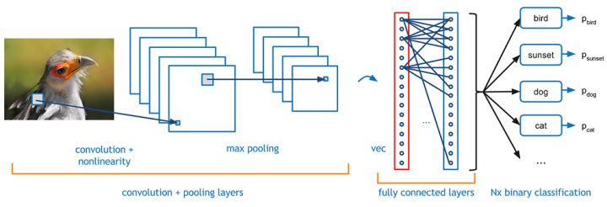
Problem setting
Conventional Convolutional Neural Network consists
Conv-layers
Not limit to the size of the input
Fully connected layers
The number of nodes depends on the size of the flattened conv-layers/ inputs

Slide 3
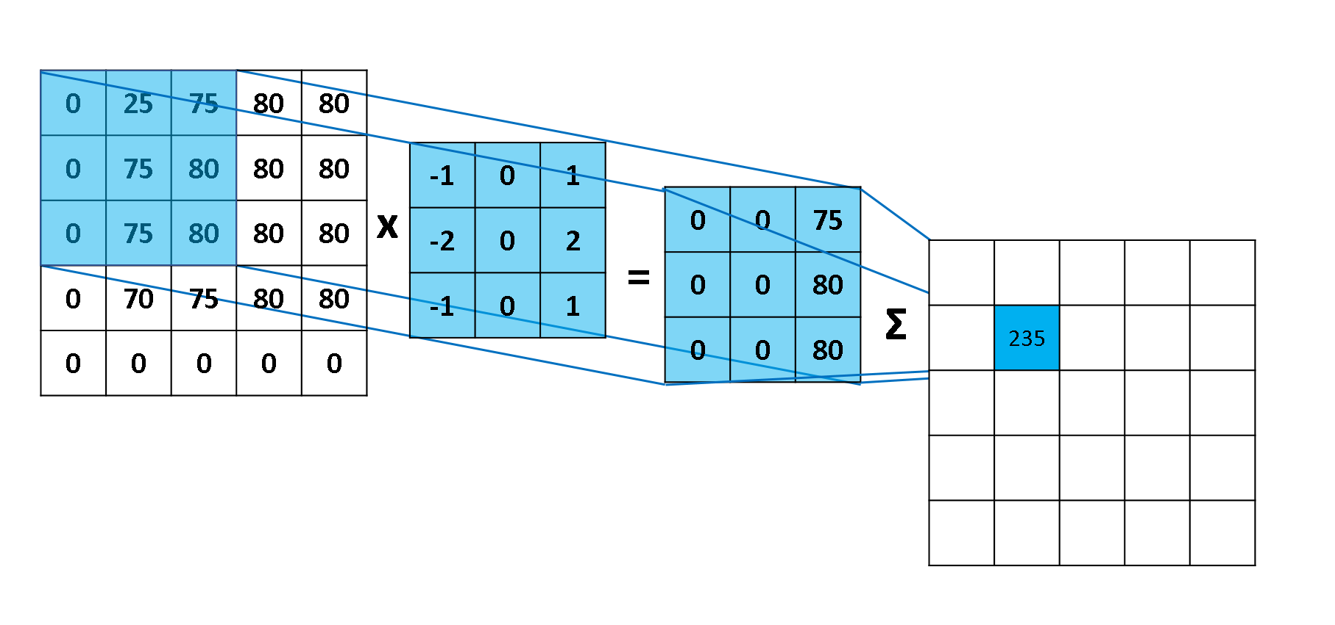
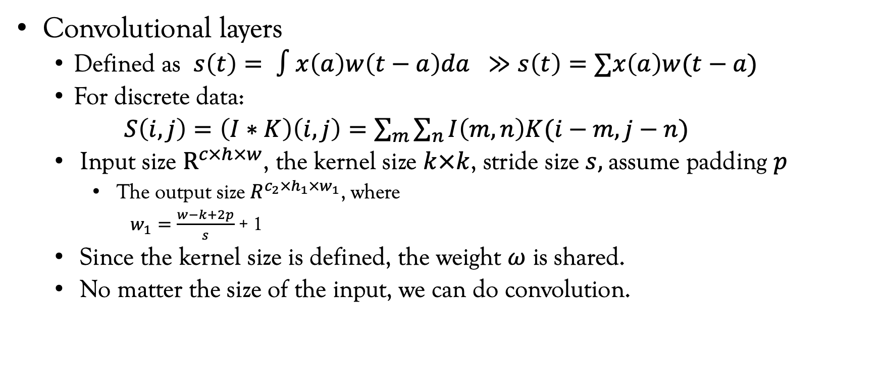
Problem setting
Convolutional layers
Defined as $s\left(t\right)= ∫x\left(a\right)w\left(t−a\right)da ≫s\left(t\right)=∑x\left(a\right)w(t−a)$
For discrete data:
$S\left(i,j\right)=\left(I∗K\right)\left(i,j\right)=\sum_{m}{\sum_{n}{I\left(m,n\right)K(i−m,j−n)}}$
Input size $R^{c×h×w}$, the kernel size $k×k$, stride size $s,$assume padding $p$
The output size $R^{c_{2}×h_{1}×w_{1}}$, where
$w_{1}=\frac{w−k+2p}{s}$ + 1
Since the kernel size is defined, the weight $ω$ is shared.
No matter the size of the input, we can do convolution.

Slide 4
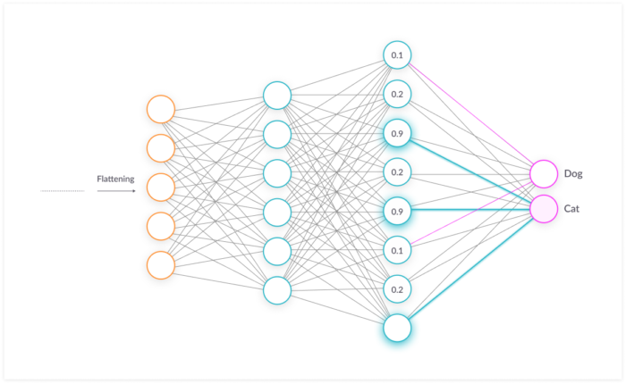
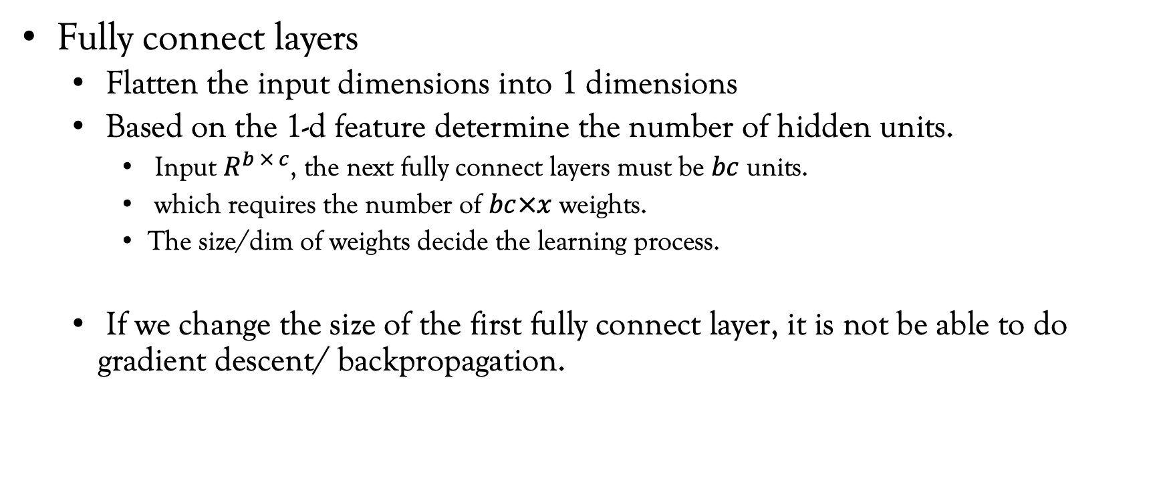
Problem setting
Fully connect layers
Flatten the input dimensions into 1 dimensions
Based on the 1-d feature determine the number of hidden units.
Input $R^{b × c}$, the next fully connect layers must be $bc$ units.
which requires the number of $bc×x$ weights.
The size/dim of weights decide the learning process.
If we change the size of the first fully connect layer, it is not be able to do gradient descent/ backpropagation.

Slide 5
A dynamic, differentiable process required !!

Slide 6
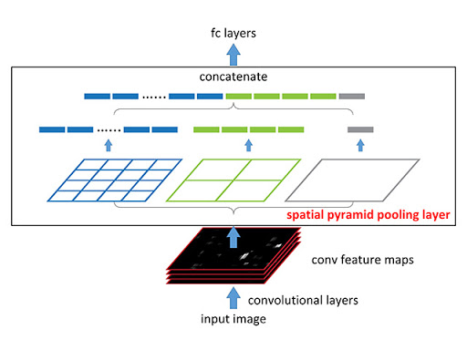
Spatial Pyramid Pooling(SSP)
Previous pooling technique
Max pooling
Average pooling
Spatial Pyramid Pooling
Pool the different size of input into the same size

Slide 7
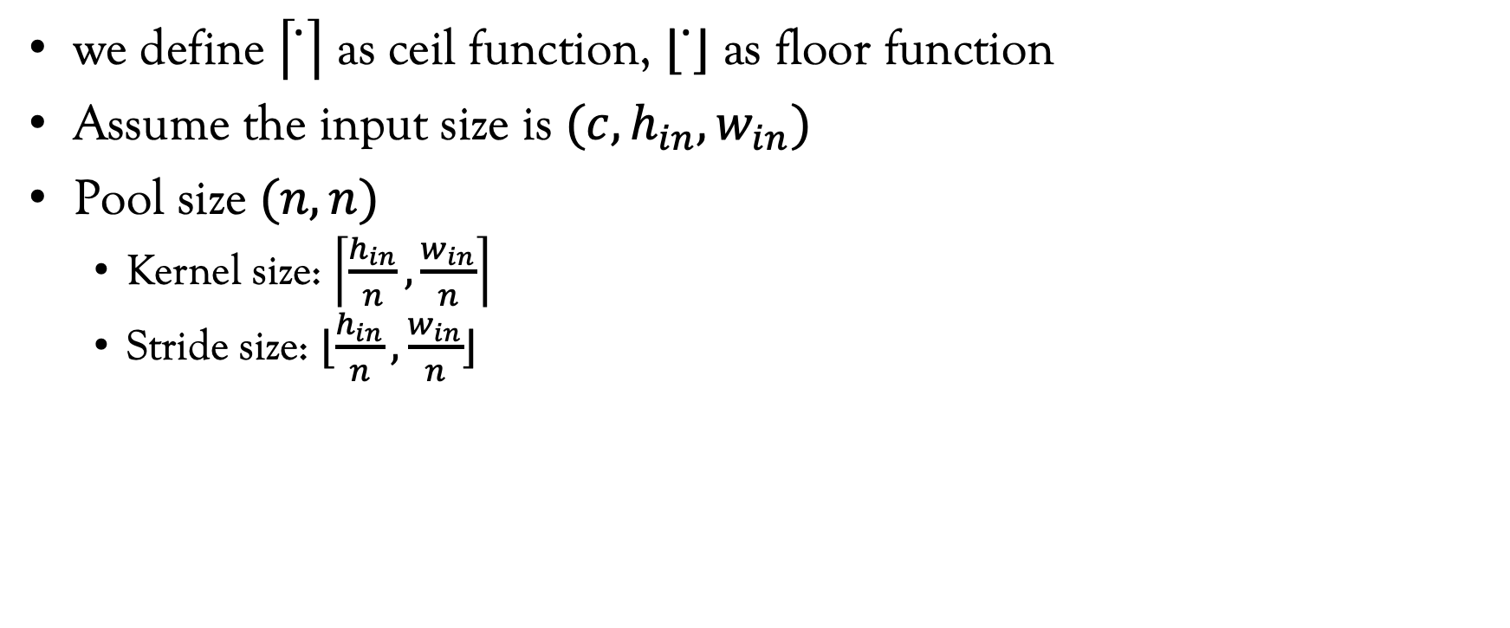
Spatial Pyramid Pooling
we define $\left\lceil ̇\right\rceil$ as ceil function, $⌊ ̇⌋$ as floor function
Assume the input size is $(c, h_{in}, w_{in})$
Pool size $(n,n)$
Kernel size: $\left\lceil \frac{h_{in}}{n},\frac{w_{in}}{n}\right\rceil$
Stride size: $⌊\frac{h_{in}}{n},\frac{w_{in}}{n}⌋$

Slide 8
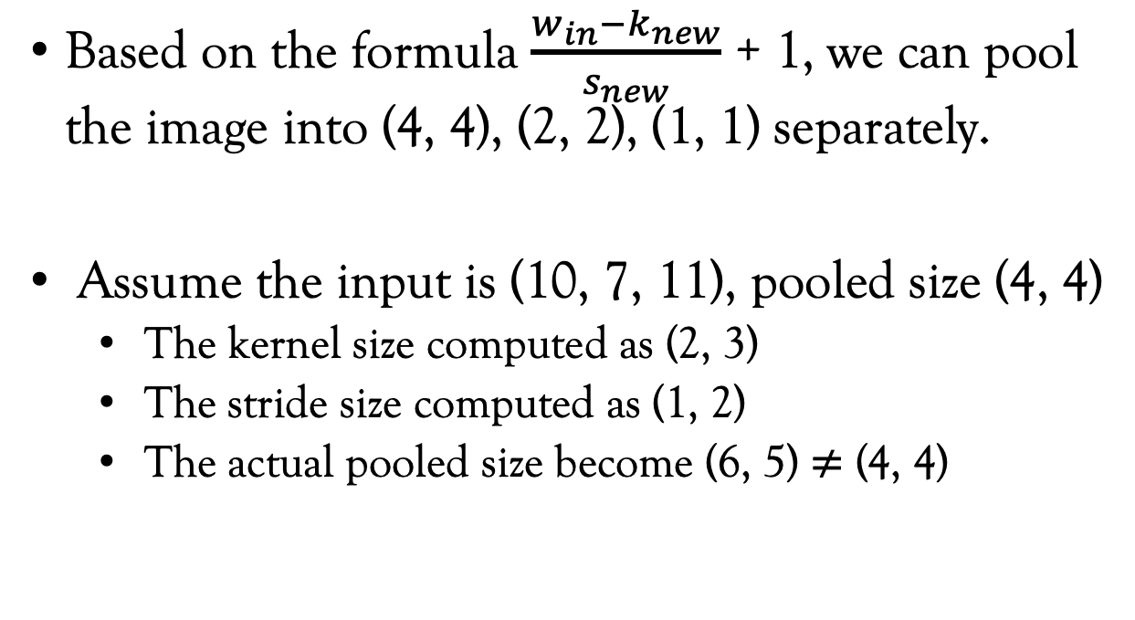
Spatial Pyramid Pooling (Issue)
Based on the formula $\frac{w_{in}−k_{new}}{s_{new}}$ + 1, we can pool the image into (4, 4), (2, 2), (1, 1) separately.
Assume the input is (10, 7, 11), pooled size (4, 4)
The kernel size computed as (2, 3)
The stride size computed as (1, 2)
The actual pooled size become (6, 5) $≠$ (4, 4)

Slide 9
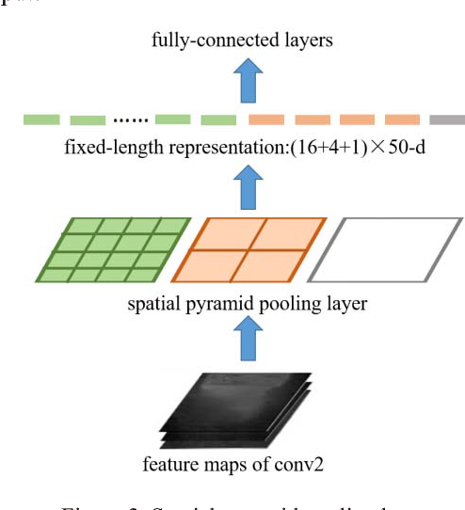
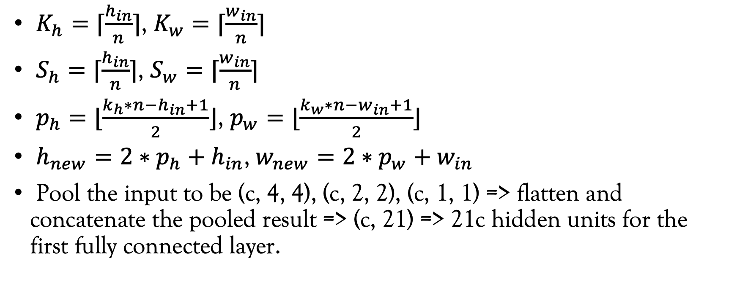
Spatial Pyramid Pooling with padding (fixed)
$K_{h}=⌈\frac{h_{in}}{n}⌉$, $K_{w}=⌈\frac{w_{in}}{n}⌉$
$S_{h}=⌈\frac{h_{in}}{n}⌉$, $S_{w}=⌈\frac{w_{in}}{n}⌉$
$p_{h}=⌊\frac{k_{h}∗n−h_{in}+1}{2}⌋$, $p_{w}=⌊\frac{k_{w}∗n−w_{in}+1}{2}⌋$
$h_{new}=2∗p_{h}+h_{in}$, $w_{new}=2∗p_{w}+w_{in}$
Pool the input to be (c, 4, 4), (c, 2, 2), (c, 1, 1) => flatten and concatenate the pooled result => (c, 21) => 21c hidden units for the first fully connected layer.

Slide 10
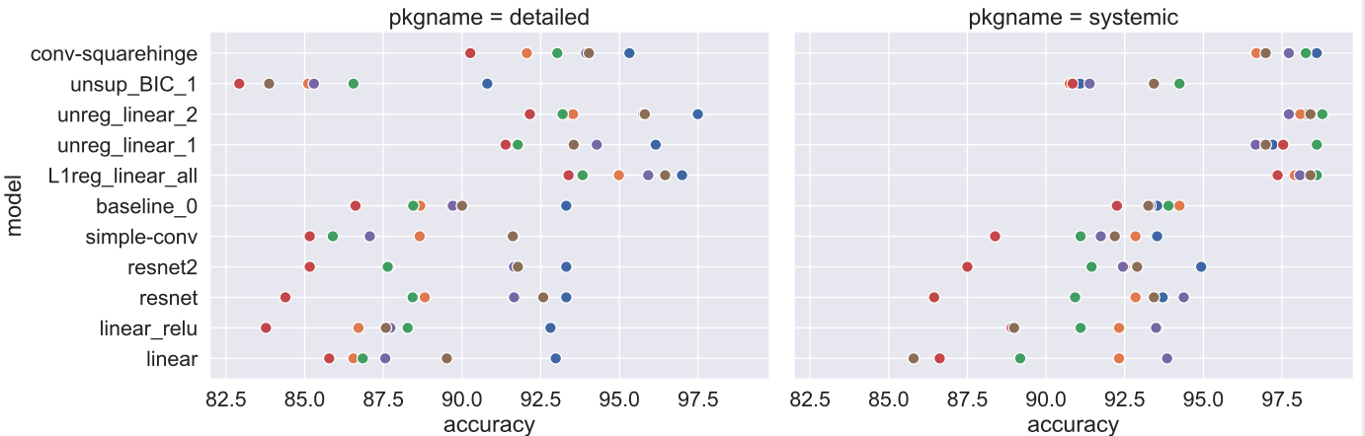
Our problem
1-D data signal with the different sample number of each observations
Implemented the square hinge loss^{[2]} with raw data
The processed same size data does not perform as well as feature engineered linear learning process
[2]: Alexandre Drouin, et al. Maximum Margin Interval Trees

